Slide 1
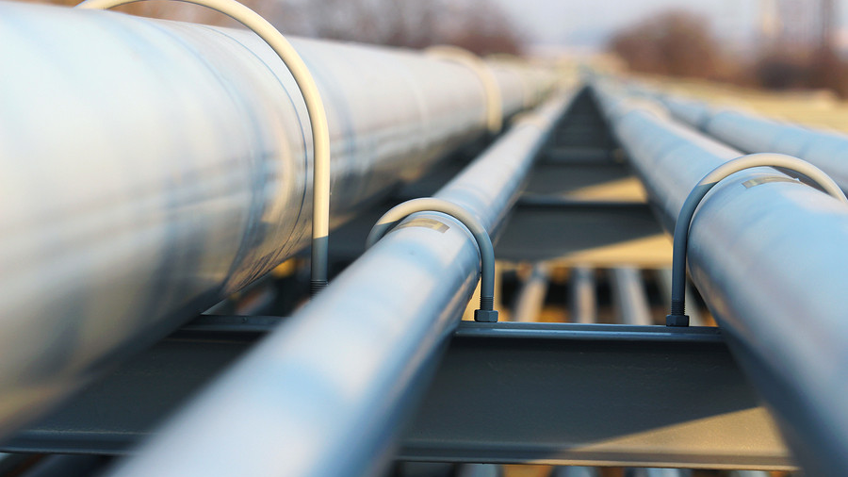
PIPELINE MANAGER
The first centralized repository for cooperative pipeline design and review

Slide 2
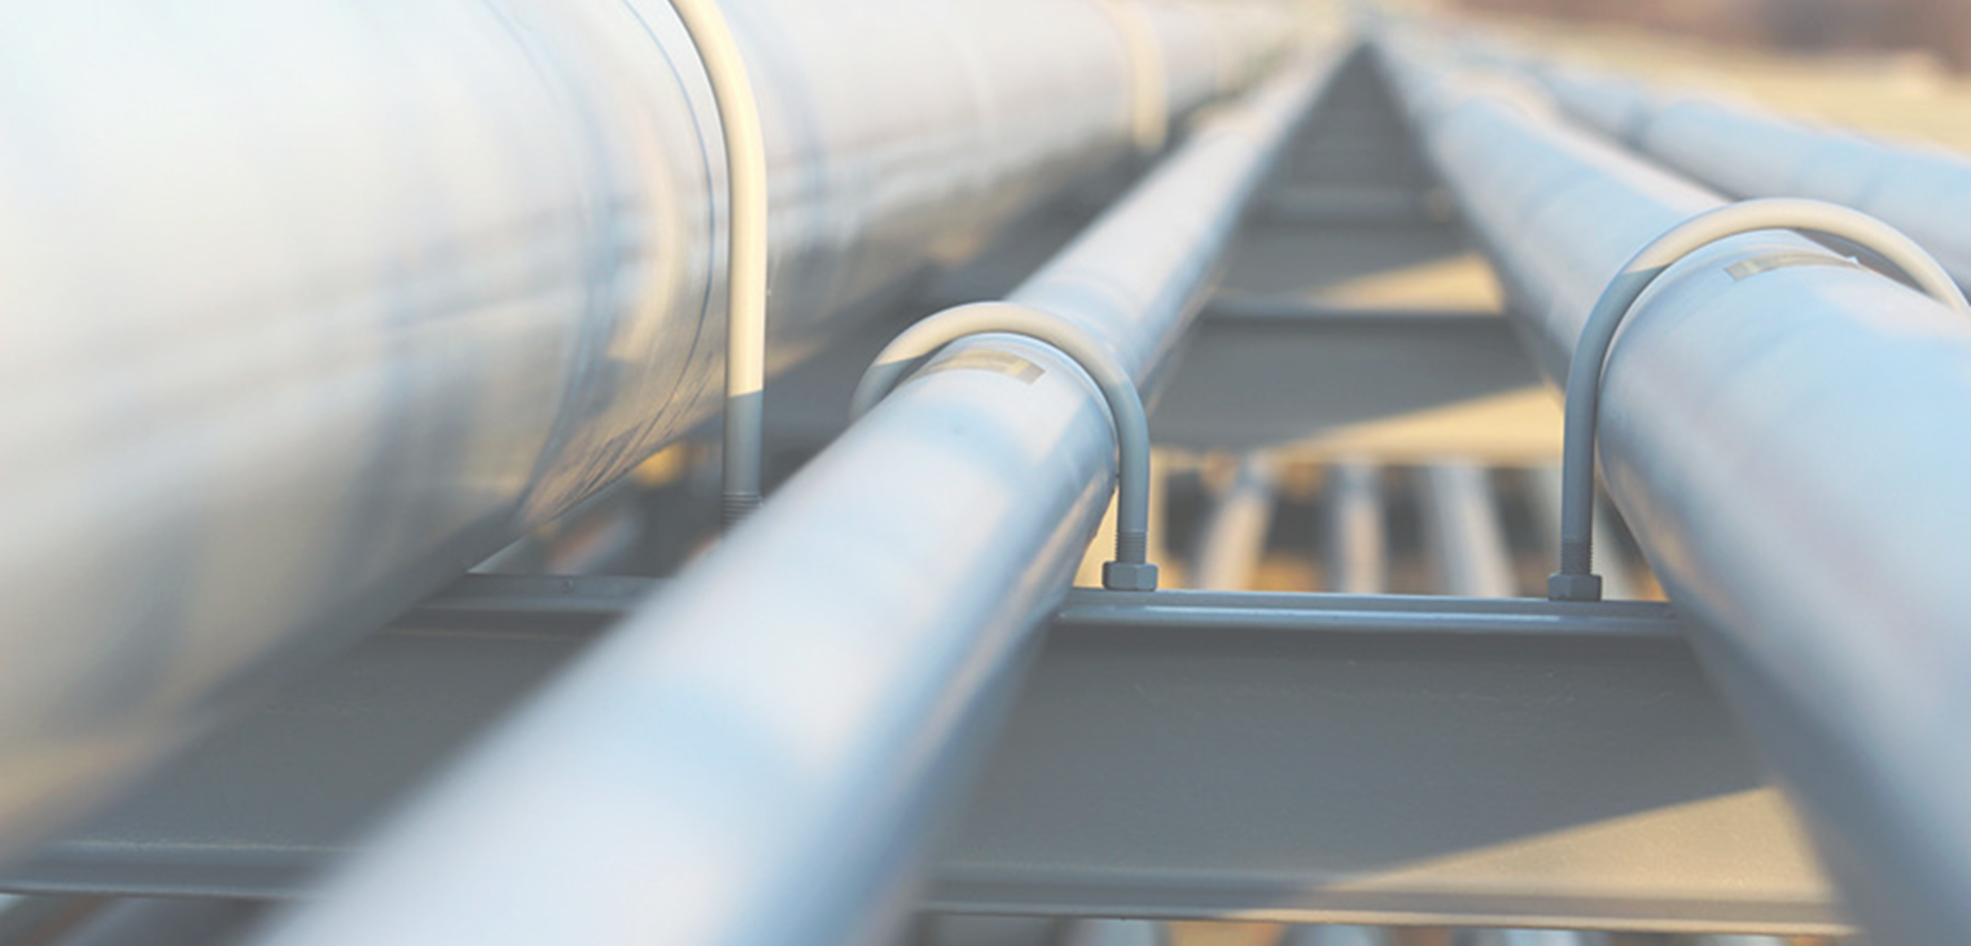
Centralized Version Control
When did we introduce these changes?
Is this the last version?
In which version there was such part?
Centralized version control of piping designs
PipeLine Manager simply and automatically generates versions of your drawings
You can inspect them and, if necessary, do a roll back to undo changes
Simple workflow
The past development stages and the current state of the project are clear for everyone, including colleagues working remotely

Slide 3
Sync Viewer
Where is located this valve in the 3D plant?
What subsystem does this component belong to?
What is the function of this component?
Hierarchical navigation of schematics in sync with isometries
Explore drawings hierarchically, cross-referencing 2D, 3D and logical representations
Select elements in one drawing to highlight it automatically in all other representations
Quickly understand drawings and schematics
Use multiple resources to untangle complex information and answer your questions

Slide 4
Diff Viewer
What components have been affected by this change?
Are we sure that all attributes have been updated?
Why did you change also this part?
Side-by-side multi format differences viewer
Quickly identify additions, deletions, and modifications between different versions and formats
Effectively review changes
Make sure nothing is missing and what has changed is correct.
Every new version is closer to the final one

Slide 5
Integration
Smart P&ID
Work in progress
AVEVA P&ID
E3D
.pcf .xml
PipeLine Manager
Smart Isometrics
Comos
Smart 3D
Engineering base
DB
SAP

Slide 6
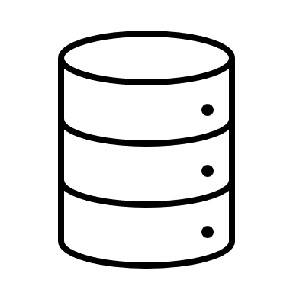
Two step version creation
Create and share a new version of the piping with two easy steps
1 Select the source program
2 Select the drawing to import
PipeLine Manager
The new version is safe and available for the team
v4
v3
v2
v1
Version DB

Slide 7
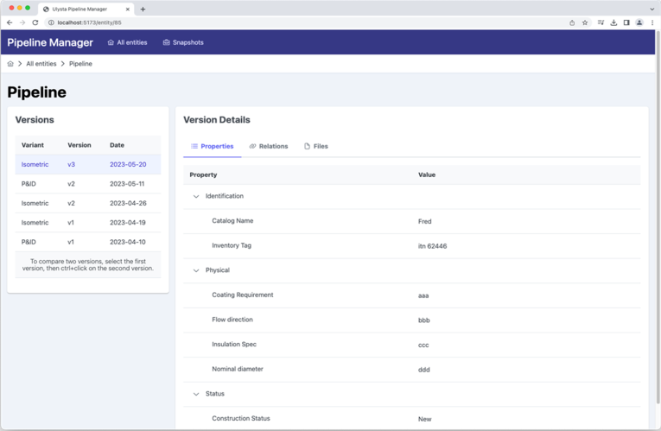
Inspect old versions
View properties from previous versions of Smart P&ID and Smart 3D in one place

Slide 8
Quick Navigation
Select a part to view its properties

Slide 9
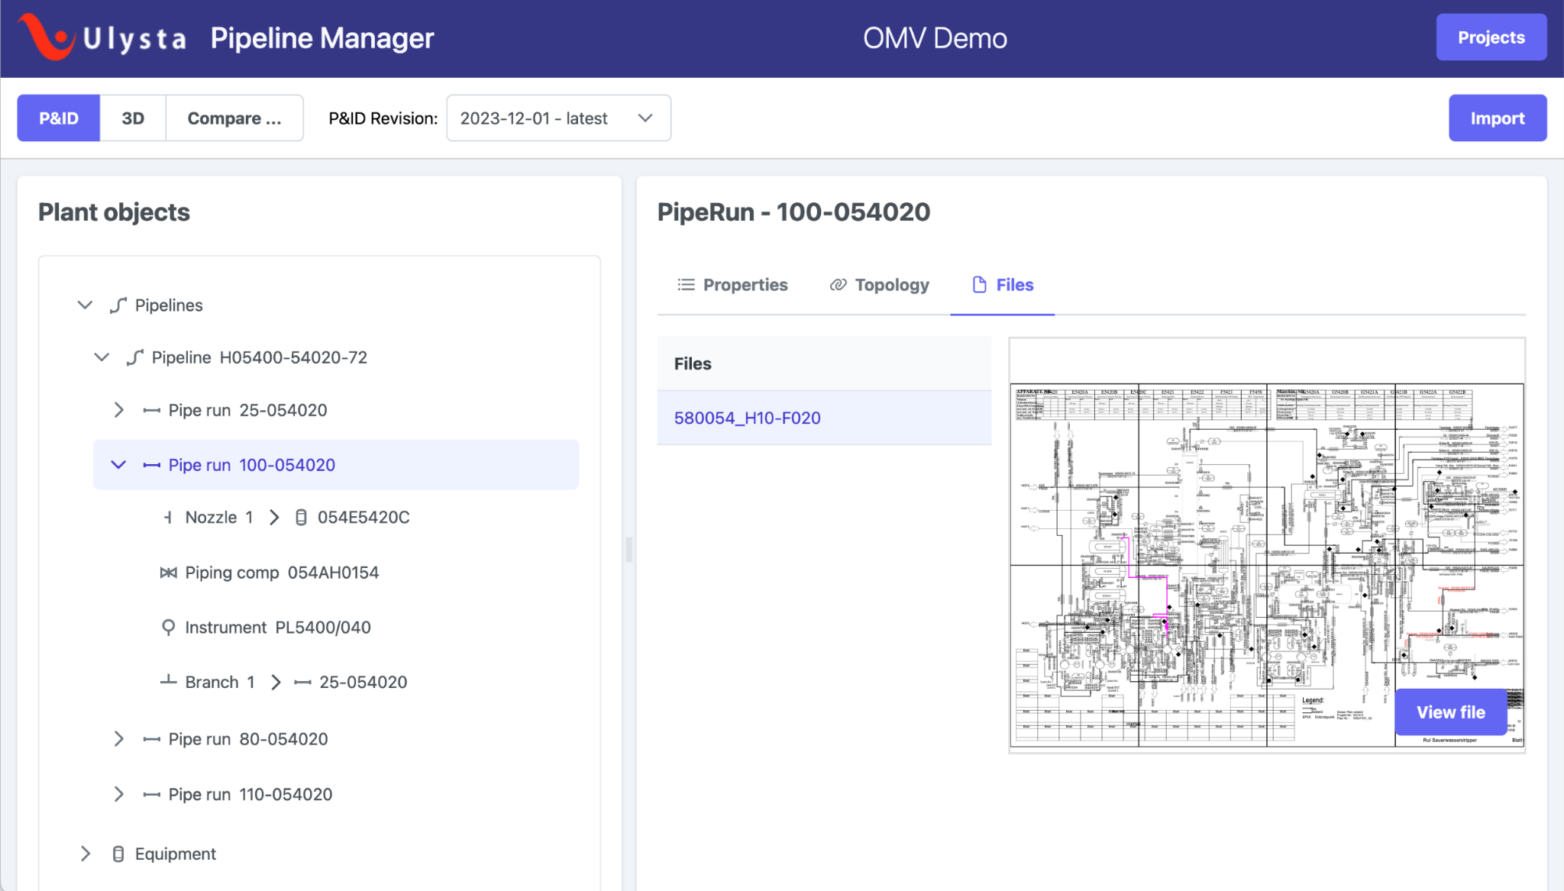
Quick Navigation
Select components in the tree viewer to highlight them on the drawing and vice versa

Slide 10
Quick Navigation
Easy search of imported parts by name, type, source system and any attribute

Slide 11
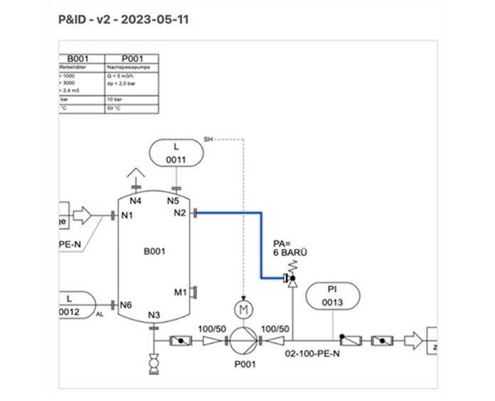
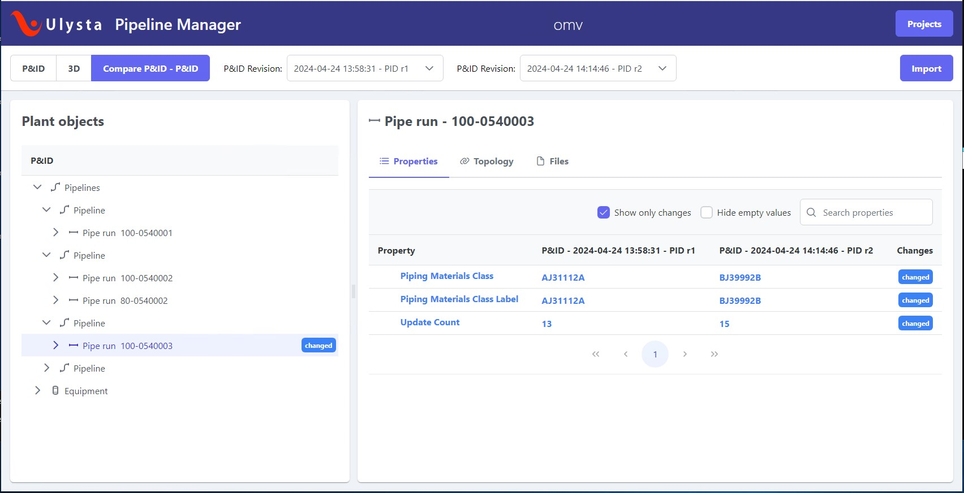
Review Changes Side by Side
Compare different versions of P&IDs graphically

Slide 12
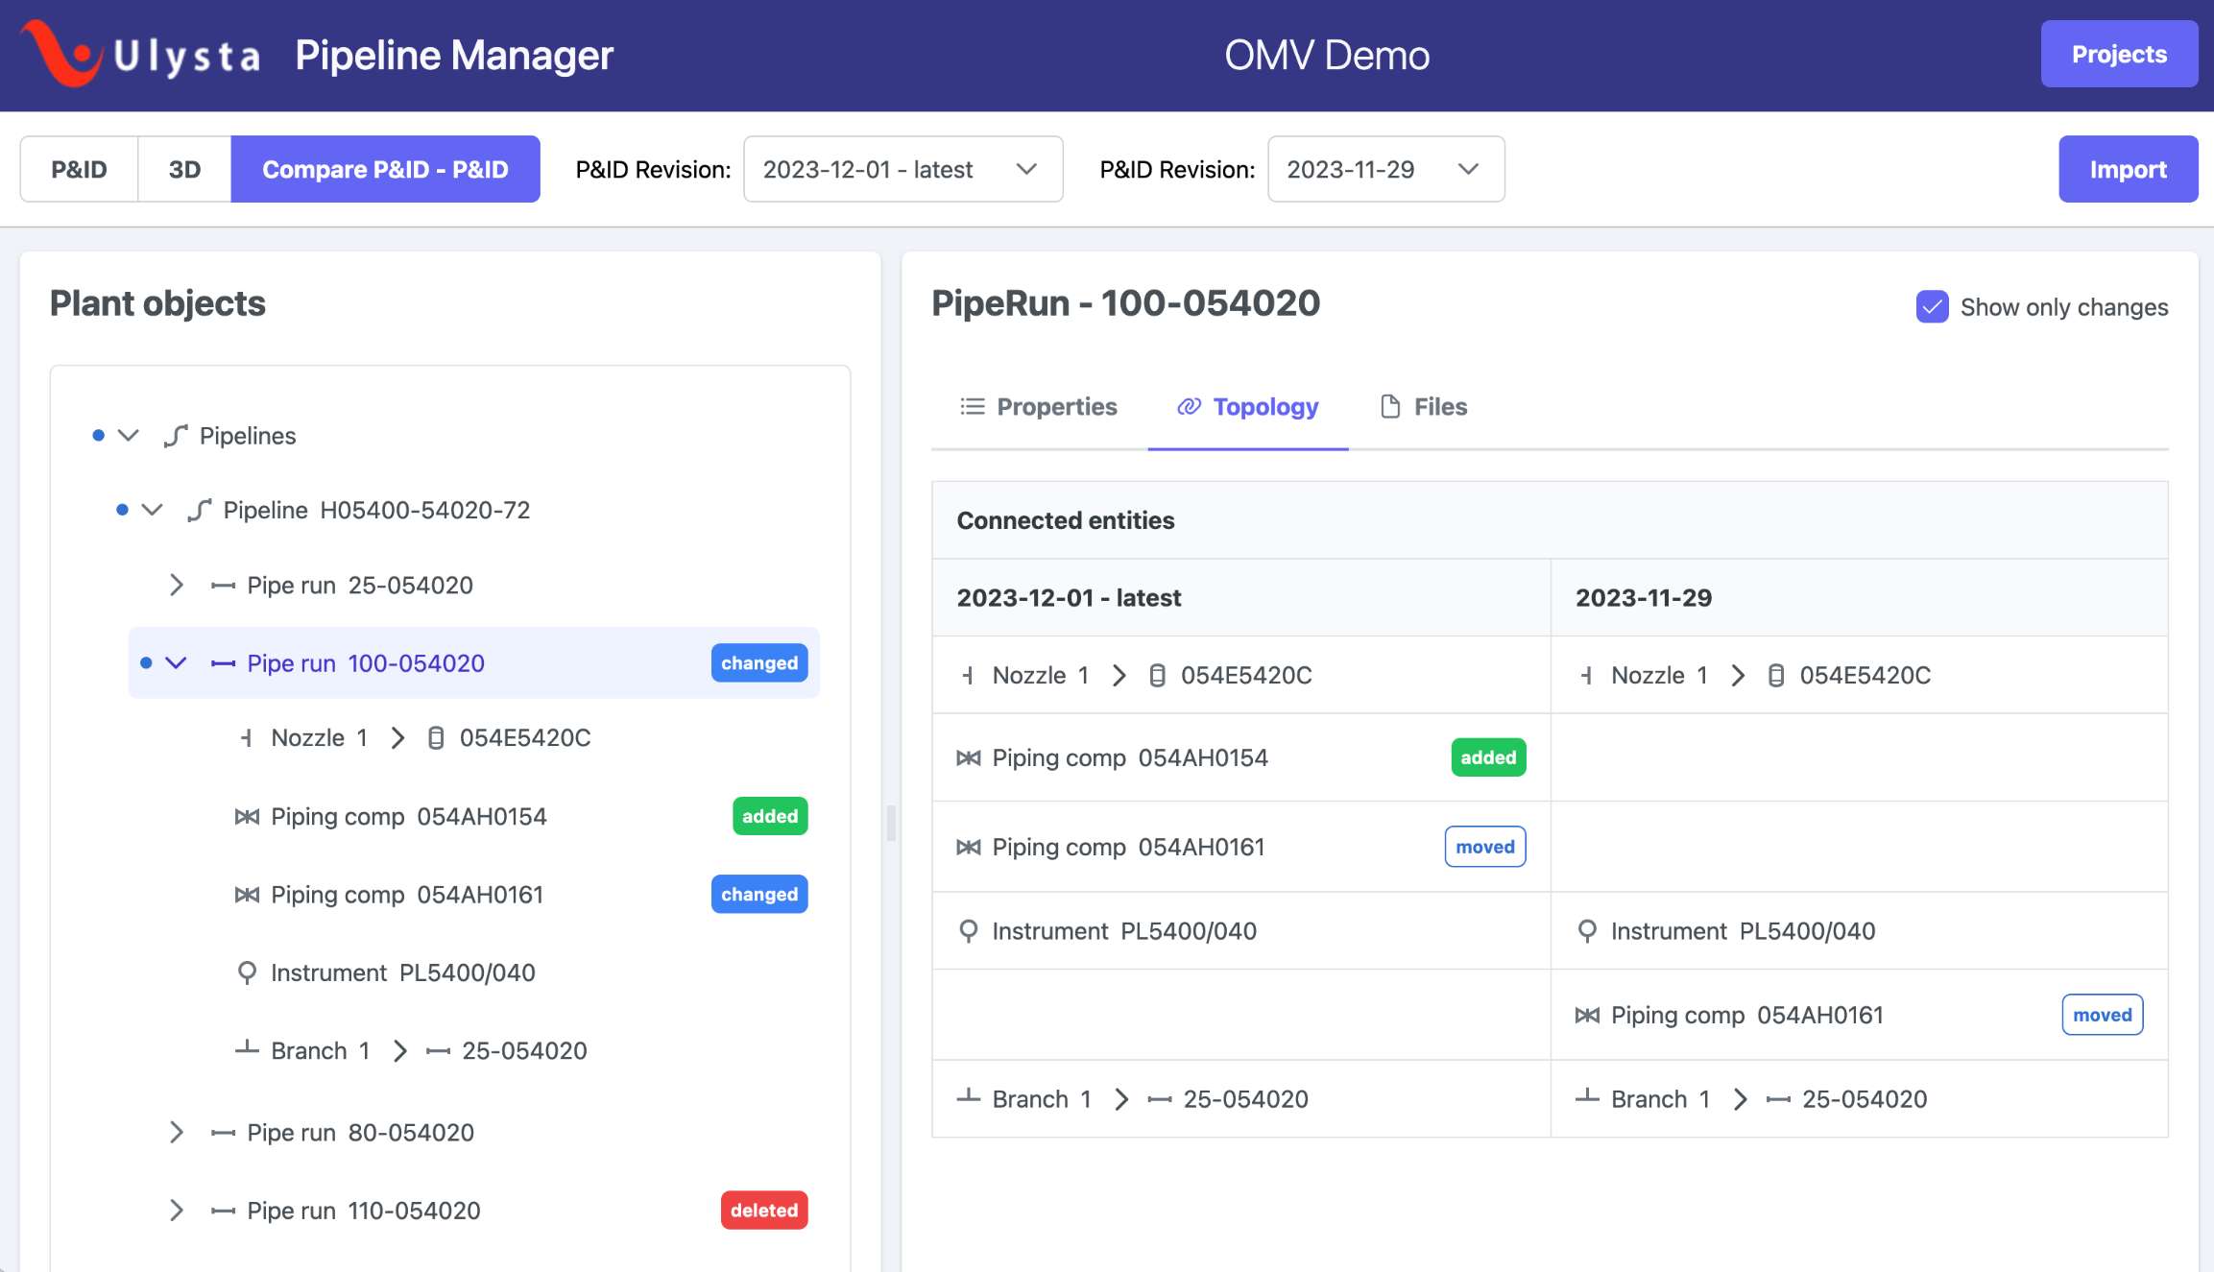
Review Changes Side by Side
Compare different versions of P&ID graphically
And view logical changes in topology

Slide 13
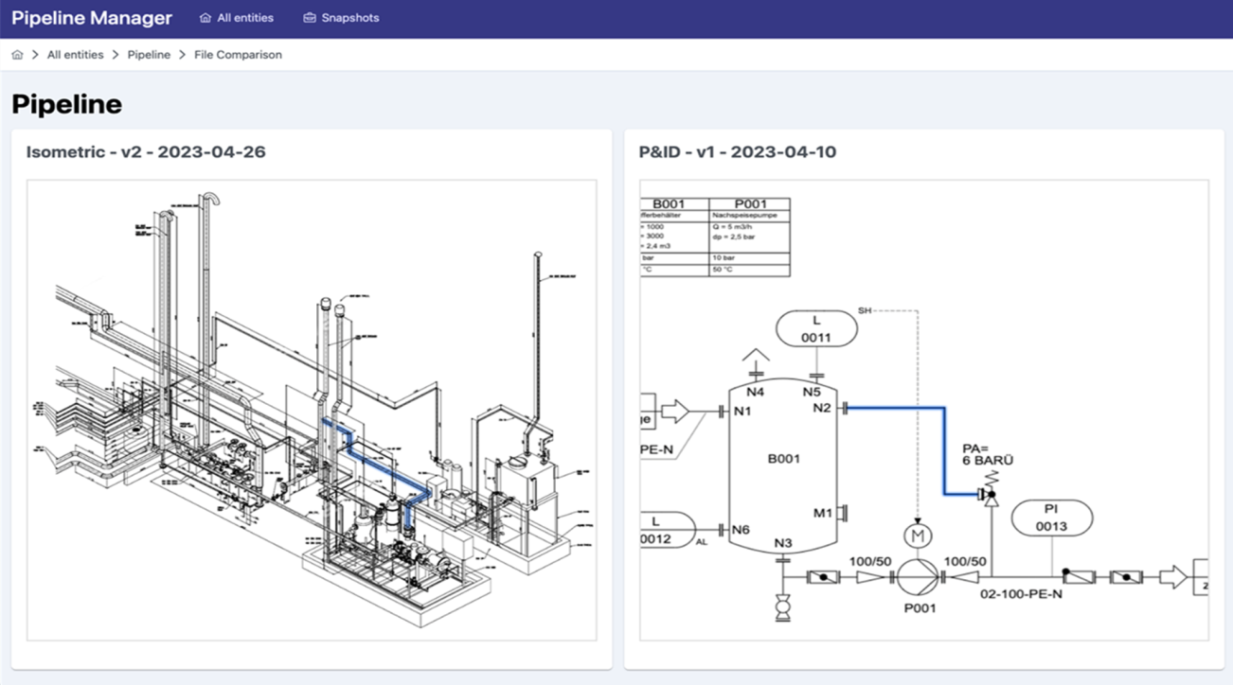
Review Changes Side by Side
Compare different versions of P&IDs
And view logical changes in topology
Compare isometrics against P&ID

Slide 14
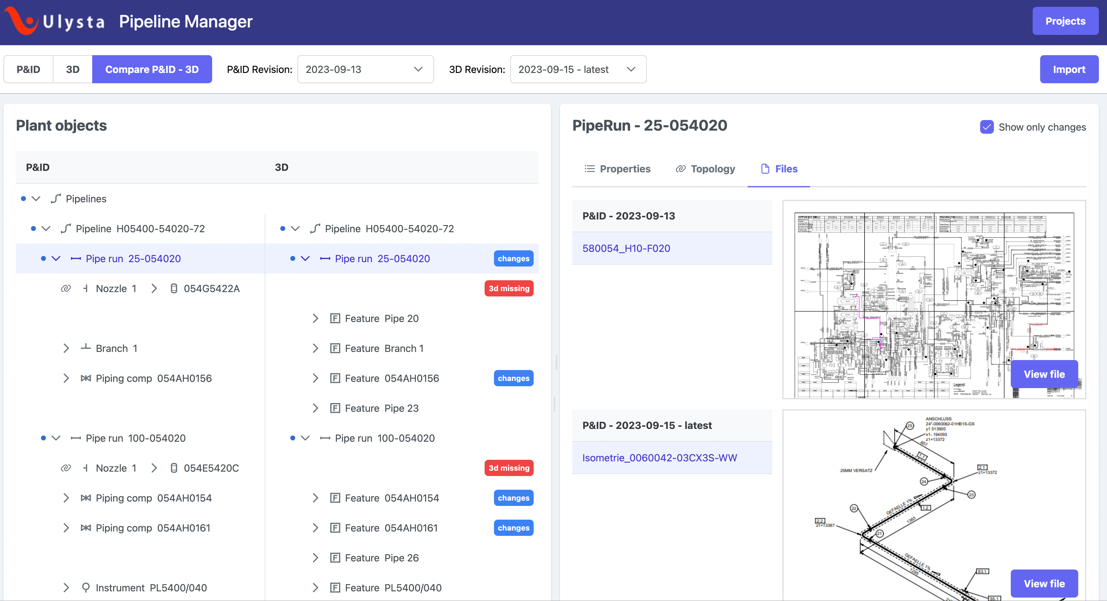
Review Changes Side by Side
Compare different versions of P&IDs
And view logical changes in topology
Compare isometrics against P&ID
And their topology

Slide 15
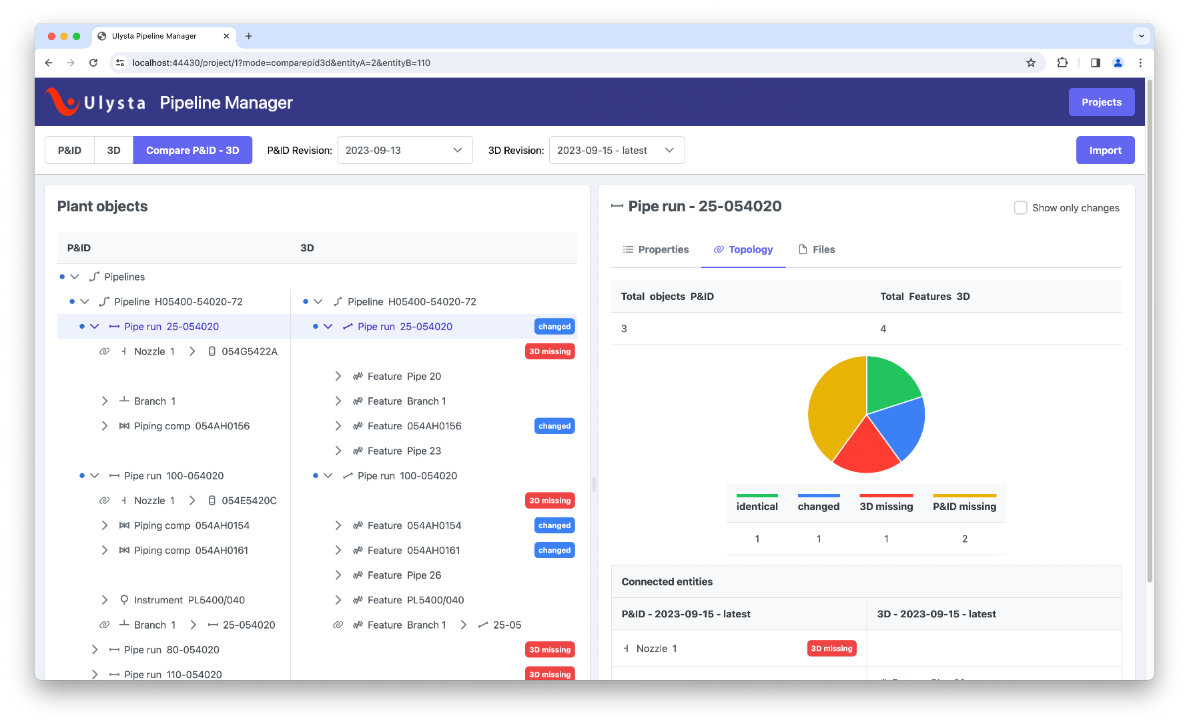
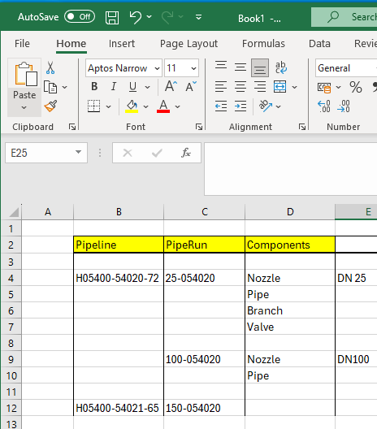
Summary/ Report
See the summary of the changes

Slide 16
Review Changes Side by Side
Compare different versions of P&IDs
Different attribute names in Smart P&ID and Smart 3D can be matched
And view changes in topology
Drawing A
Parameter | Value
Attribute A | 123 cm
Attribute B | Copper
Attribute C | 8 hp
Attribute D | 44 kg
Attribute E | 500 Ah
Attribute F | 230 V
Drawing B
Parameter | Value
Attribute A | 1.23 m
Attribute D | 77 kg
Attribute F | 230 V
Attribute X | steel
Attribute Y | 8 hp
Attribute Z | 115 kWh
Drawing A
P&ID | Isometric
Attribute A | 123 cm
Attribute B | Copper
Attribute C | 8 hp
Attribute D | 44 kg
Attribute E | 500 Ah
Attribute F | 230 V
Drawing B
P&ID | Isometric
Attribute A | 1.23 m
Attribute X | steel
Attribute Y | 8 hp
Attribute D | 77 kg
Attribute Z | 115 kWh
Attribute F | 230 V
Compare isometrics vs. P&ID
And their topology

Slide 17
The value of PipeLine Manager
Simplify the workflow relying on an easy versioning system
01
Easilly understand drawigs and schematics by bringing multiple information together
02
Boost up the review of each change, do not miss a single difference
03
Save money avoiding human errors and rework
04

Slide 19
PIPELINE MANAGER
Keep piping data straight
Or
Step by step closer to the result

